Slide 1
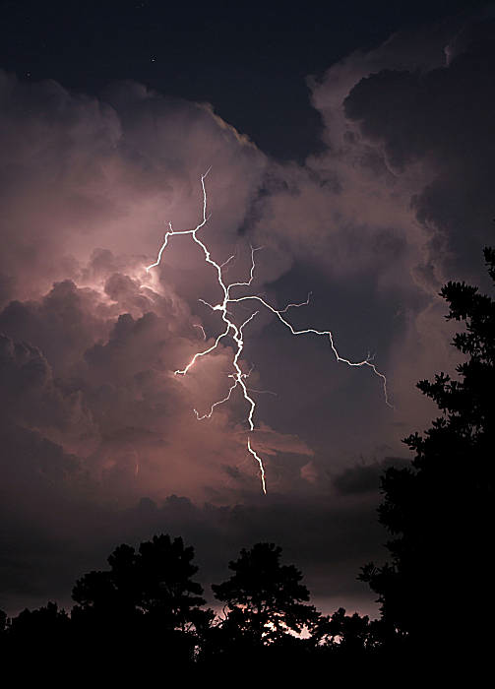
Inquiry Project: What Can We Learn From Weather Forecasts Online? By: Laura Stokes
http://imgs.sfgate.com/c/pictures/2009/08/27/ba-texas_weather_0500524007.jpg

Slide 2
Why Weather?
I teach first grade and we have been learning about the weather in science. We have also been learning how to chart the weather and keep track of temperature based on our own observations out the window and with a thermometer.
This led me to wonder how it would be possible to chart weather accurately and where to get the information to do so on the Internet. I also wondered if my students would be successful at helping me find sites to look at.

Slide 3
What will happen?
I have offered my students opportunities to experience using a search engine, however it was minimal and in a whole group setting. I wondered if this would affect their ability to participate in the project in a positive way, or not at all.
I know many of my students have the Internet at home, but do not use it for educational purposes, so I was curious how many would have experience looking up information on a search engine.

Slide 4
Predictions
#2: I also predicted that a few would be able to give me more information on how to find out about our local weather online.
#1: I predicted that most of the class would be able to give me an idea of where to find information about weather in general.

Slide 5
Prediction Background
#1 Most students could give me a general idea on where to search for weather.
This was based on the fact that we have done projects before where I have told them step by step and I hoped that they would be able to recall this prior knowledge for the project.
#2 A few students could tell me where to find information on local weather.
This was due in part to their ability to use the computer with ease and the knowledge that they spent time outside of school on their computers.

Slide 6
The plan…
Since this is a first grade classroom, I will begin the plan in a whole group setting with the computer hooked up to the T.V. set.
I will ask them what to do if I want to look up information about weather.
Guided questions:
“Where do you go on the Internet when you want to learn about something?”
“What would I want to type in?”
“Does it matter what I type?”

Slide 7
The plan continued…
If they are able to be successful with that task, I will move in to the more detailed idea of weather in our local area.
Guided questions:
“Where did I go to find out about weather?”
“Will I keep the same words or will I want to type in more information?”
“Are there any other sites that I might be able to look at to find out about weather in our local area?”

Slide 8
The plan continued…
Once we have gathered the information on where to find our local weather, I will have them focus on two websites.
From the two sites we will compare their data along with our own to decide which is more accurate for telling us the local weather, and why it is.

Slide 9
Data
At first when we began the project, the students were very hesitant to offer up any clue that they had ever had experience working with a search engine.
With some guided questions, starting with the idea of “Google”, they were able to offer up many ideas of what we could type in:
“If you try a really big hurricane I bet we’ll see something cool here.” -Dermontti
“Do the different kinds of precipitation (that had been our word of the week) because that’s what my daddy did for my homework and we got some pictures.”-Hannah

Slide 10
Data…
They were offering me ideas, and we would type them in as they said them, one at a time. One idea was weather, which gave us 480,000,000+ pages. I would ask them, “Does this tell us about the weather near us?”
They would answer, “no.”
This led me to my guided questions, as well as a few others, “Where are we?”
Some would say, “Texas.” So we began looking up weather in Texas.

Slide 11
Data
The idea of looking up the weather in Texas, showed them that we could narrow down our search. I continued to question them as to where exactly we were?
They figured out it was Killeen, Texas so we began to type in weather in Killeen Texas. We talked about why this was different than just typing in weather.
They noted that weather, as a key word, brought up different types, and not necessarily the current weather. They also noticed that Texas weather showed different areas of Texas, but not the area we wanted.

Slide 12
Data
Once we had the Killeen Texas weather in as our key words, I told them there were 440,000 different pages that came up and how were we going to decide which to look at.
“Just look at them all, we can help.” Simone
“Pick 10 and if you don’t like them pick some more.” Shelby
“My parents just watch the news.” Austin
This was where my project went a little bit off of the course that I had planned.

Slide 13
Stop… Rethink… Redesign
Austin had given me a great idea! He said that his parents just watch the news. I asked him if he knew what news station they watched, and he said, “News 25.” I knew it was KXXV so I asked the children if they thought that a news station would have a website. They said, “yes”
We opened a new window and typed in KXXV news in the search, and immediately found their website.

Slide 14
Data
Within the KXXV website, I asked the children what they noticed about the homepage of the station?
“There’s WEATHER!” –a few different students.
“It shows the temperature, and the weather symbol.” Jalen
I noted that this would be one of the sites we were going to use.

Slide 15
Data
We went back to our original Google search and clicked on various websites. I asked them which ones they felt were easiest to read? Then I asked them to vote on which things they felt made a website easier or harder to read? They could choose one or all of the choices: fewer words, pictures, temperature, or video.

Slide 16
When asked what was most important, pictures had the most votes, followed by fewer words, and temperature. Video had only 6 students.

Slide 17
Data…
We went back to our original Google search and decided that based on their votes, we would use Weather.com as our other source because it offered fewer words, more pictures and it had the temperature listed.
This had been a site we used for a previous activity and they were familiar with it as well.
We charted the weather for 5 days using both of the sites. I kept it up on a word document so we could add to it each day.

Slide 18
Our Weather Graph
Day of the week | Weather.com | KXXV.com
Monday | Temp: 85*F Scattered Thunderstorms | Temp: 89*F Cloudy with a chance of rain
Tuesday | Temp: 86*F Scattered Thunderstorms | Temp: 89*F Cloudy with a chance of rain
Wednesday | Temp: 76*F Sunny | Temp: 72*F Partly cloudy
Thursday | Temp: 80*F Mostly Cloudy | Temp: 88*F Thunderstorms
Friday | Temp: 79*F Partly Cloudy | Temp: 81*F Thunderstorms

Slide 19
Data…
By the third day, my students were really beginning to realize a pattern. The weather.com site and the KXXV site were never the same.
We talked about ways to determine which was more accurate and why?
“We could just look out the window.” –Dermontti
“ We could just do it ourselves and see which is the same.” Jalen

Slide 20
Data…
Despite this was a technology based project, I couldn’t avoid the great answer Jalen had come up with to evaluate the site. Again, I went in a different direction than I had planned.
We took our own data and recorded the weather ourselves for the last two days.

Slide 21
Final Determination…
When we had finished our week of weather charting, we looked at all of the data.
My students determined that the KXXV site was more accurate than the Weather.com site. On Thursday, Weather.com had said partly cloudy and they couldn’t believe that it could be wrong, because when we looked out our window, it was thunder and lightening.

Slide 22
What now?
Through the experiment we did, my students realized that you can’t always trust what you read on the Internet.
We talked about the things they had determined made a good site choice: fewer words, pictures, temperature and video.
I asked if they felt this was always true because we had used Weather.com and it had those things, however it was not more accurate than the KXXV site.

Slide 23
How do you know which sites are the best?
We continued to evaluate the two sites. We talked about what the difference was between the two sites.
Guided question:
“Where does Weather.com focus on? Just Killeen Texas, or everywhere?”
“Where does KXXV focus on? The Killeen area in Texas, or everywhere?”
“What kind of a site is KXXV?”

Slide 24
The facts…
We talked about the fact that KXXV was a specific news station for our area and that they specialized solely in the Killeen, Texas area.
They came to the conclusion that Weather.com was a far bigger based website that would be more prone to making mistakes for weather forecasts because its main focus was weather everywhere, not in our immediate area.

Slide 25
Conclusion
My students and I talked about the importance of key words for a search. We looked back on how many websites came up for weather vs. weather in Killeen Texas and determined the need for specifics.
We also decided that accuracy was the best when we were looking at a specific topic.
They determined that just because a website says something does not mean it is true. You need to check more than one site and take your own knowledge into consideration when evaluating a site.

